Slide 1



Inclusion & Diversity in Open Source Projects
opensourcediversity.org
@osdiversity #opensourcediversity

Slide 2
1 – 11 %
Notes:
Anywhere between 1-11% is what studies find for participation of women in open source
According to a study by National Science Foundation in 2004 [Women, Minorities, and Persons with Disabilities in Science and Engineering] 28% of employees with computer and mathematical occupations are female

Slide 3
Gender identity
Sexual orientation
Skin color
Ability
Age
Even skill level or technical affinity
Notes:
… and that leaves out plenty of people

Slide 4
Diverse teams work better
Harvard Business Review McKinsey Stanford Business Inc.com
Notes:
Lots of studies conclude the positive impact a diverse team has on innovation and the bottom line
https://hbr.org/2016/11/why-diverse-teams-are-smarter
https://www.mckinsey.com/business-functions/organization/our-insights/why-diversity-matters
https://www.gsb.stanford.edu/insights/diverse-backgrounds-personalities-can-strengthen-groups
https://www.inc.com/adam-vaccaro/diversity-and-performance.html

Slide 5
Rudeness
45% witnessed, 16% experienced
Name calling
20% witnessed, 5% experienced
Unwelcoming language or content
women 25%, men 15%
GitHub Open Source Survey 2017
Notes:
http://opensourcesurvey.org/2017/
Stereotyping men: 2% women: 12%
Unsolicited sexual advances m: 3% w: 6%

Slide 6
21% of people
who experienced negative behavior
stopped contributing to the project
GitHub Open Source Survey 2017
Notes:
http://opensourcesurvey.org/2017/

Slide 7
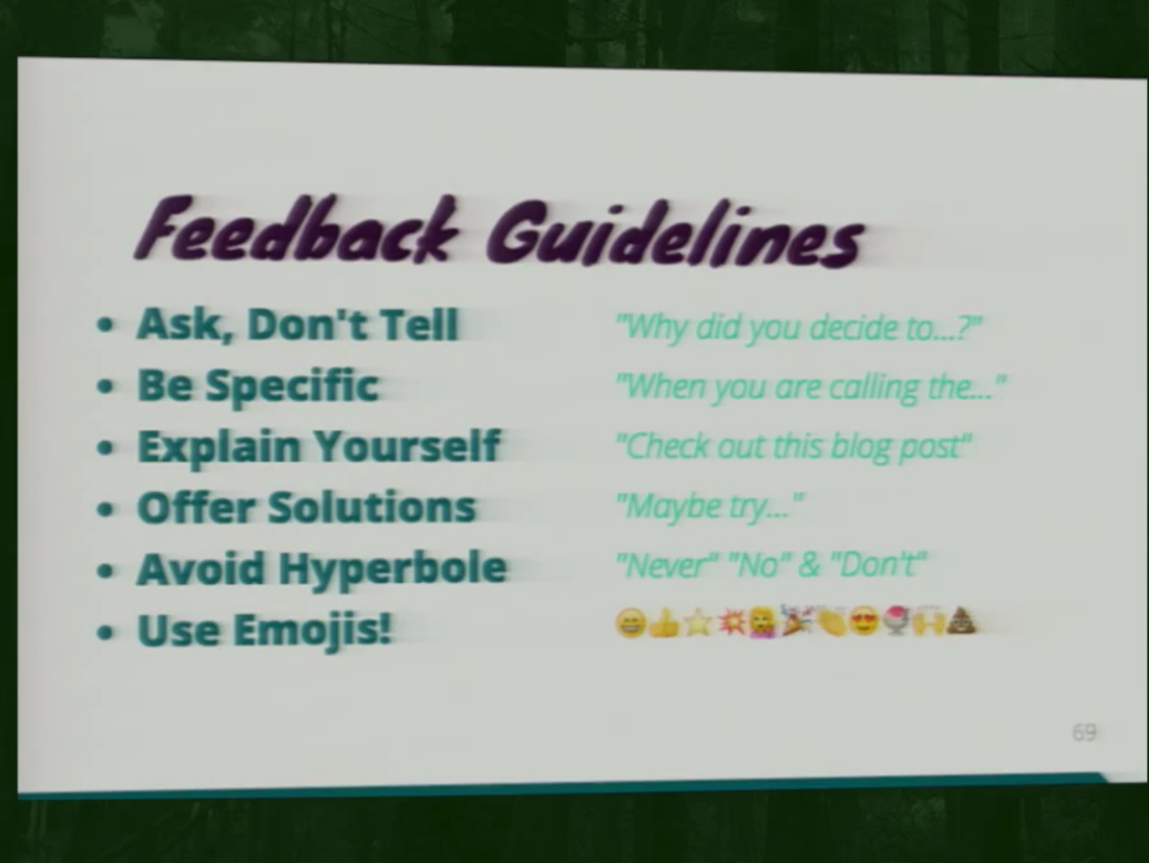
Una Kravets at CascadiaFest
Notes:
This is a talk about getting designers involved – so people usually not familiar with open source, and also not so represented. A lot of the recommendations are also true for getting people of underrepresented groups involved.
http://2015.cascadiajs.com/speakers/una-kravets

Slide 8
Women are more likely to seek out help directly (29% vs 13%) from people they already know well (22% vs 6%),
rather than ask for help from strangers in a public forum.
GitHub Open Source Survey 2017
Notes:
http://opensourcesurvey.org/2017/

Slide 9


Diversity Tickets

Slide 10


Slide 11
Thank you
& join the community!
opensourcediversity.org
@osdiversity #opensourcediversity

